Slide 1



Project 2: TradeReco
Team Members:
Pranav Satheesan
Jude YogArajAH
Anthony Harrison
Mustafa Mufti

Slide 2
Motivation
In the previous project we had created an Interactive chart for individual tickers to assess performance based on Cumulative Returns, Annual Volatility compared with SP500 and Sharpe Ratio.
This time we tried to use a Decision Tree model to make a prediction on the Buy-Sell recommendation for any US-based stock.
The model is expected to allow a user to enter the ticker code for a stock of their choice and arrive at a conclusion based on the outputs from two different models to reaffirm the user’s decision.

Slide 3
Model Summary
The model uses the Random Forest Classifier as an estimator using 4 signals:
Bollinger Bands
Moving Average (50- and 100-day) Crossover
Exponential Moving Average (1- and 10-day windows) Crossover
Volatility Trend Crossovers
Two models with different max_depth parameters (3 and 4).
Finally, root mean square error (RMSE) value and F-1 scores of each of these models were used to provide a recommendation to the user.

Slide 4
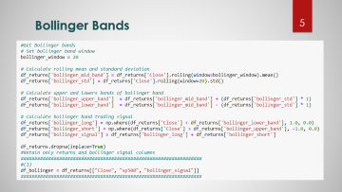
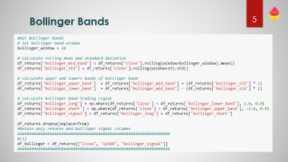
Data Clean-up and Model Training
Yahoo Finance API (yfinance library) was used to pull historical closing prices for a particular ticker.
To provide meaningful predictions, a check is introduced to provide a message if data was less than 3 years.
As part of the clean-up process all NAs were dropped using df.dropna()
Signal 1: As the first independent variable, we created Bollinger Bands providing signals as 1 and -1 for Buy and Sell, respectively.

Slide 5

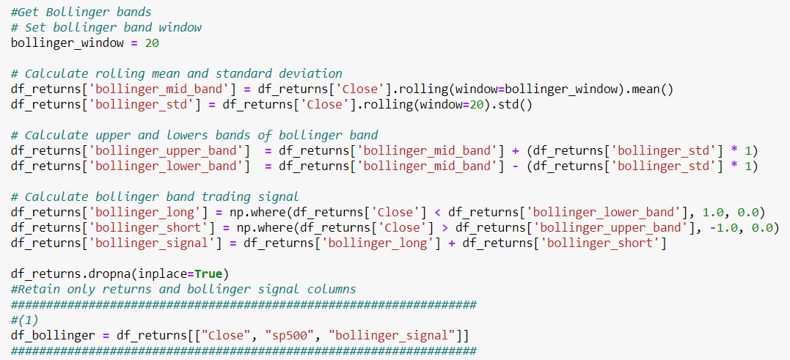



Bollinger Bands

Slide 6
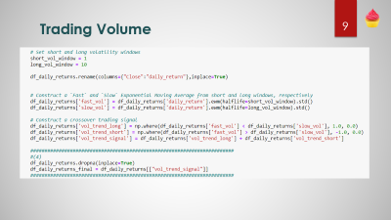
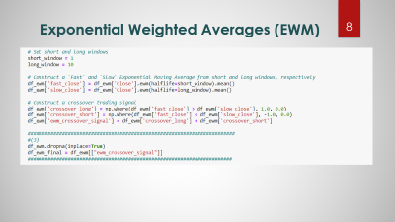
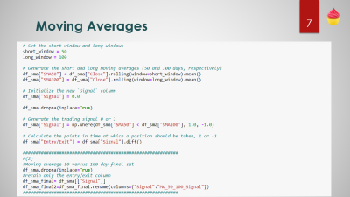
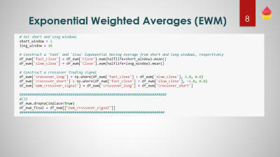

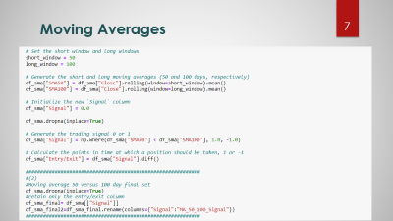
Data Clean-up and Model Training
Signal 2: Moving averages (50- and 100-day) were used to generate signals as 1 and -1 for Buy and Sell, respectively.
Signal 3: EWMs (1- and 10-day window) were used to generate signals as 1 and -1 for Buy and Sell, respectively.
Signal 4: Volatility Trends (1- and 10-day window) were used to generate signals as 1 and -1 for Buy and Sell, respectively.

Slide 7
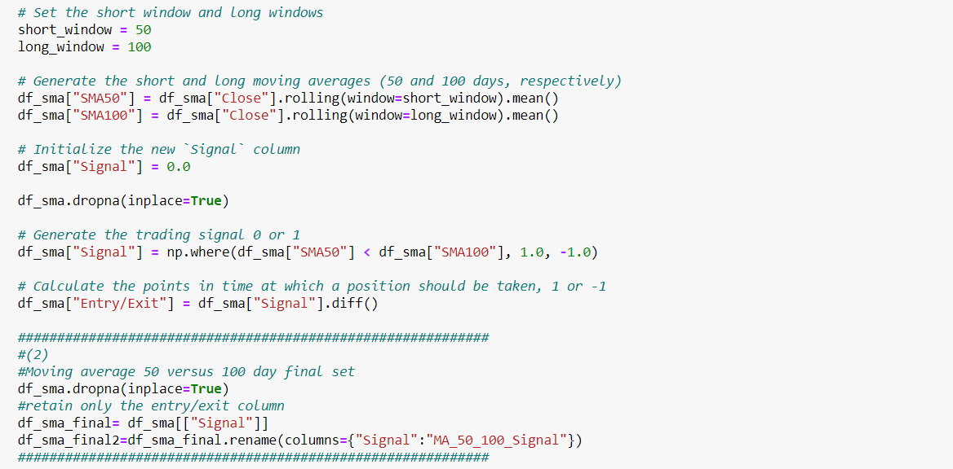
Moving Averages

Slide 8
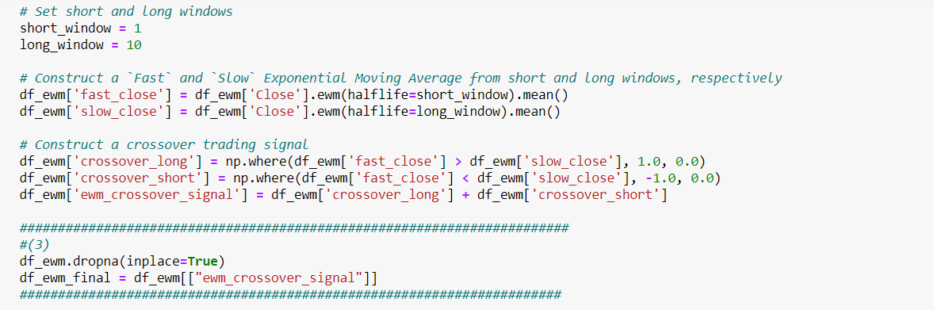
Exponential Weighted Averages (EWM)

Slide 9
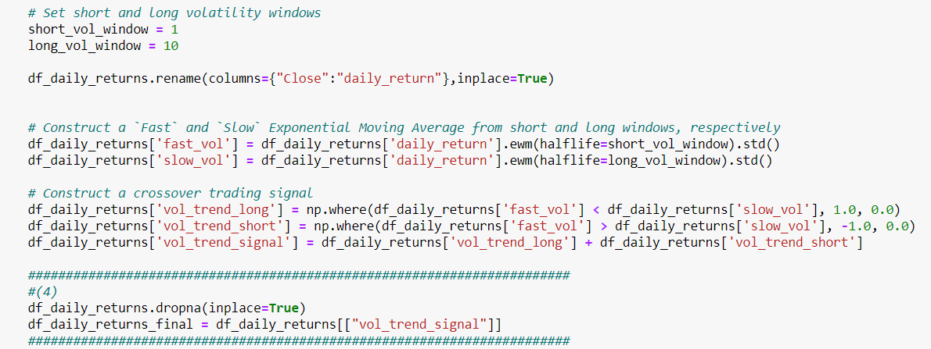
Trading Volume

Slide 10
Data Clean-up and Model Training
All the 4 Signals were appended into the main dataframe and used as independent variables.
Dependent variable was introduced to predict: 1 (Buy) or 0 (Sell)
The data was split into 80-20 for training and testing respectively.

Slide 11
Findings and Observations
Increasing the max_depth parameter from 3 to 4 did not necessarily result in a better accuracy. The output was random based on tickers and the associated data history
Higher F-1 Score was observed for higher max_depth model for the few tickers that were tested
For the few tickers that were tested, outputs from Model 1 and Model 2, seldom differed.

Slide 12
Challenges
Shortlisting meaningful or relevant Signals was a major challenge.
Challenge 2
Challenge 3

Slide 13
Q&As + Thank You

